Slide 1
Fall 2015 Faculty Satisfaction Survey
Saturday, March 26, 2016

Slide 2
19
Total Responses
Date Created: Friday, December 11, 2015
Complete Responses: 19

Slide 3
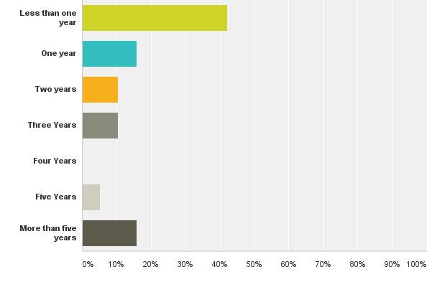
Q1: How long have you been a faculty member at ICCI?
Answered: 19 Skipped: 0

Slide 4
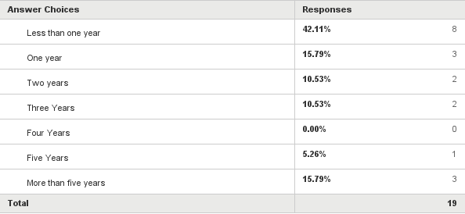
Q1: How long have you been a faculty member at ICCI?
Answered: 19 Skipped: 0

Slide 5
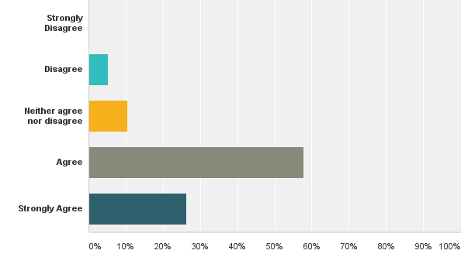
Q2: ICCI is a welcoming and friendly environment.
Answered: 19 Skipped: 0

Slide 6
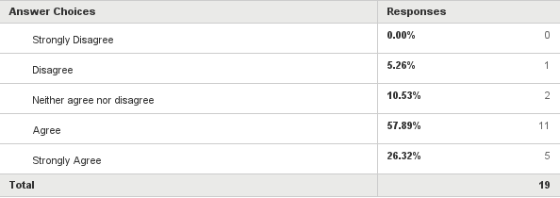
Q2: ICCI is a welcoming and friendly environment.
Answered: 19 Skipped: 0

Slide 7
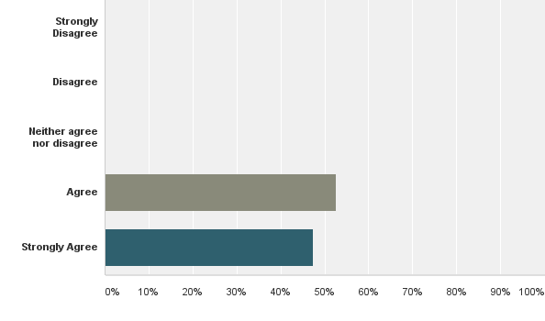
Q3: I feel valued and respected as a teacher by my students.
Answered: 19 Skipped: 0

Slide 8
Q3: I feel valued and respected as a teacher by my students.
Answered: 19 Skipped: 0

Slide 9
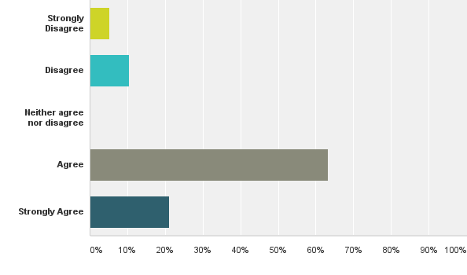
Q4: I feel valued and respected as a teacher by the college.
Answered: 19 Skipped: 0

Slide 10
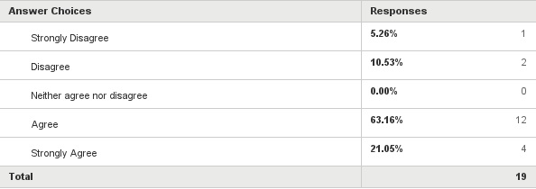
Q4: I feel valued and respected as a teacher by the college.
Answered: 19 Skipped: 0

Slide 11
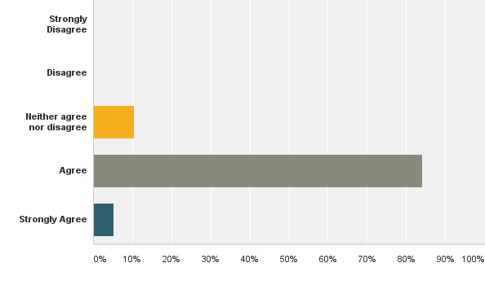
Q5: ICCI is committed to high quality academics.
Answered: 19 Skipped: 0

Slide 12
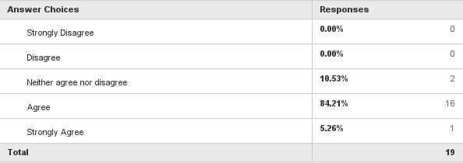
Q5: ICCI is committed to high quality academics.
Answered: 19 Skipped: 0

Slide 13
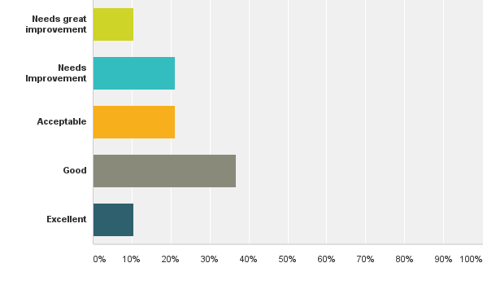
Q6: How satisfied are you with your overall experience as a faculty member at ICCI?
Answered: 19 Skipped: 0

Slide 14
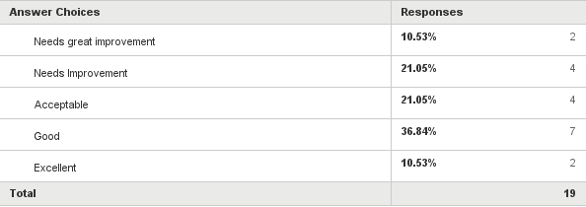
Q6: How satisfied are you with your overall experience as a faculty member at ICCI?
Answered: 19 Skipped: 0

Slide 15
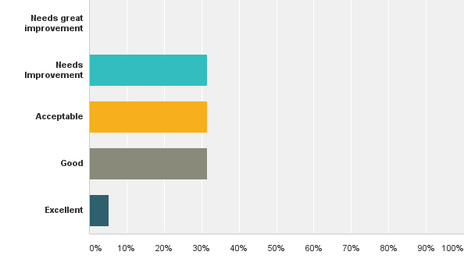
Q7: How satisfied are you with the academic ability of your students?
Answered: 19 Skipped: 0

Slide 16
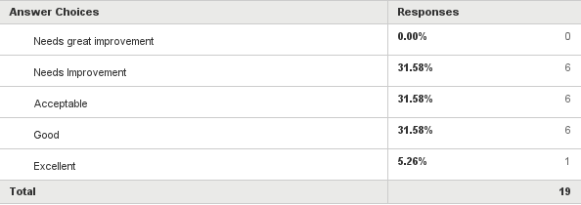
Q7: How satisfied are you with the academic ability of your students?
Answered: 19 Skipped: 0

Slide 17
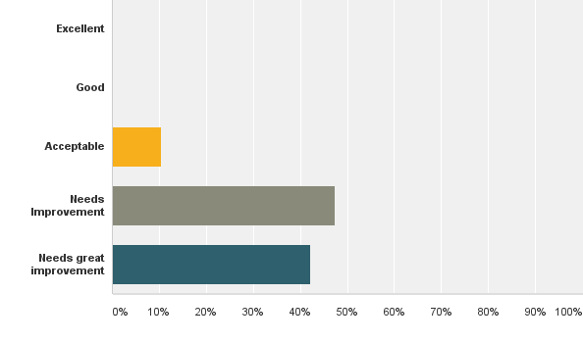
Q8: How satisfied are you with your pay as a faculty member at ICCI?
Answered: 19 Skipped: 0

Slide 18
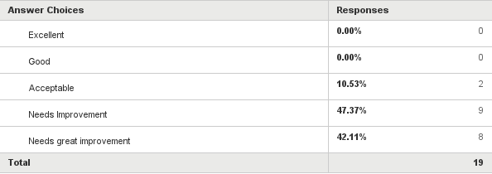
Q8: How satisfied are you with your pay as a faculty member at ICCI?
Answered: 19 Skipped: 0

Slide 19
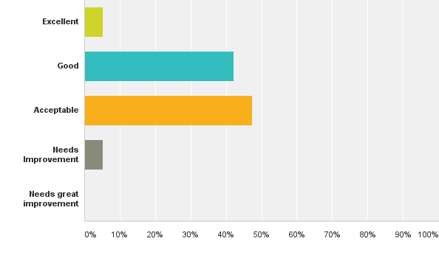
Q9: How would you rate the overall college facilities?
Answered: 19 Skipped: 0

Slide 20
Q9: How would you rate the overall college facilities?
Answered: 19 Skipped: 0

Slide 21
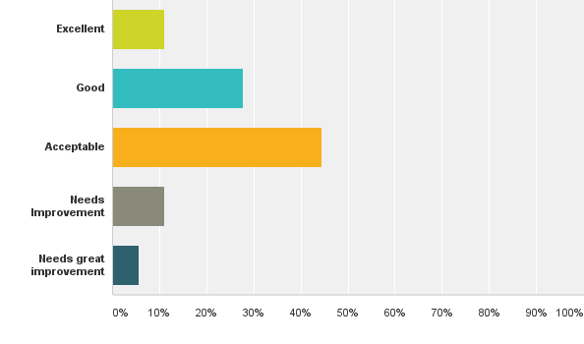
Q10: How would you rate the computer labs?
Answered: 18 Skipped: 1

Slide 22
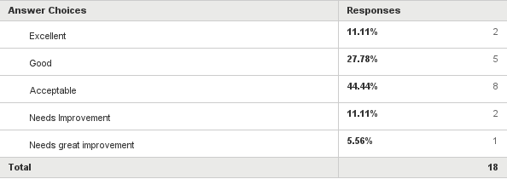
Q10: How would you rate the computer labs?
Answered: 18 Skipped: 1

Slide 23
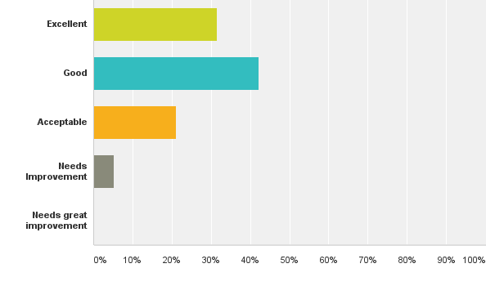
Q11: How would you rate your experience with Populi?
Answered: 19 Skipped: 0

Slide 24
Q11: How would you rate your experience with Populi?
Answered: 19 Skipped: 0

Slide 25
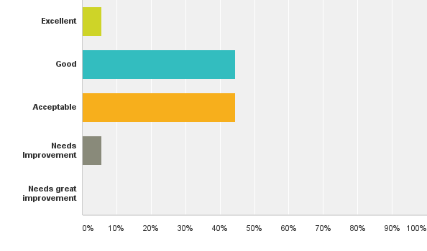
Q12: How would you rate the classrooms in Friend's Hall?
Answered: 18 Skipped: 1

Slide 26
Q12: How would you rate the classrooms in Friend's Hall?
Answered: 18 Skipped: 1

Slide 27
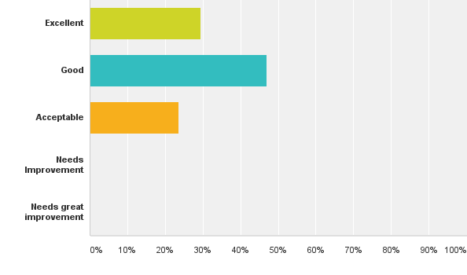
Q13: How would you rate the classrooms in McLaughlin Hall?
Answered: 17 Skipped: 2

Slide 28
Q13: How would you rate the classrooms in McLaughlin Hall?
Answered: 17 Skipped: 2

Slide 29
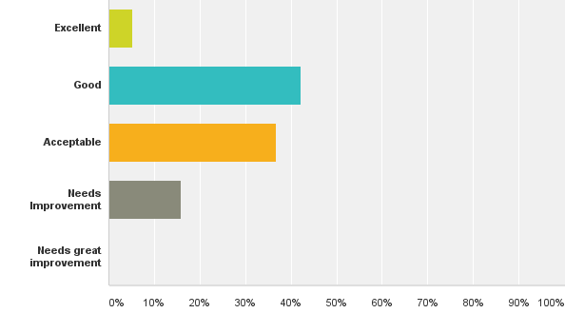
Q14: How would you rate the classrooms in Clayton Strain Hall?
Answered: 19 Skipped: 0

Slide 30
Q14: How would you rate the classrooms in Clayton Strain Hall?
Answered: 19 Skipped: 0

Slide 31
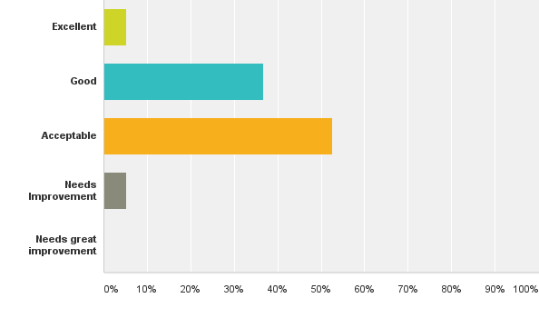
Q15: How would you rate the bathrooms?
Answered: 19 Skipped: 0

Slide 32
Q15: How would you rate the bathrooms?
Answered: 19 Skipped: 0

Slide 33
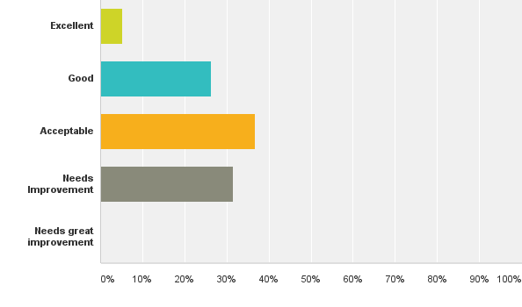
Q16: How would you rate the parking lots?
Answered: 19 Skipped: 0

Slide 34
Q16: How would you rate the parking lots?
Answered: 19 Skipped: 0

Slide 35
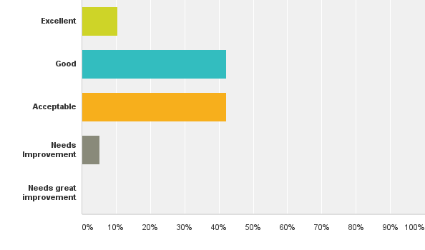
Q17: How would you rate security on campus?
Answered: 19 Skipped: 0

Slide 36
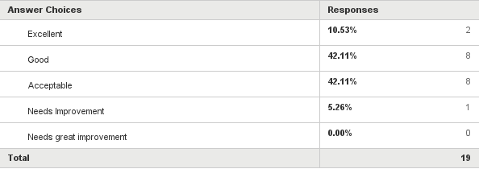
Q17: How would you rate security on campus?
Answered: 19 Skipped: 0

Slide 37
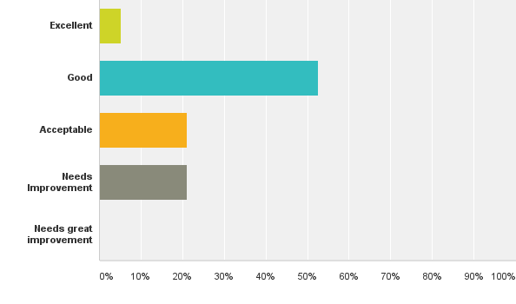
Q18: How would you rate lighting on campus?
Answered: 19 Skipped: 0

Slide 38
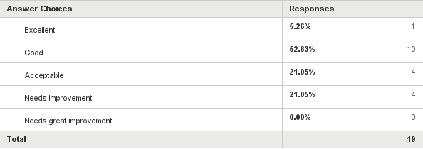
Q18: How would you rate lighting on campus?
Answered: 19 Skipped: 0

Slide 39
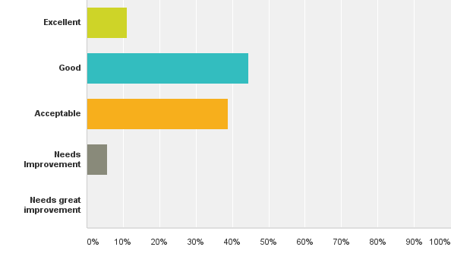
Q19: How would you rate safety on campus?
Answered: 18 Skipped: 1

Slide 40
Q19: How would you rate safety on campus?
Answered: 18 Skipped: 1

Slide 41
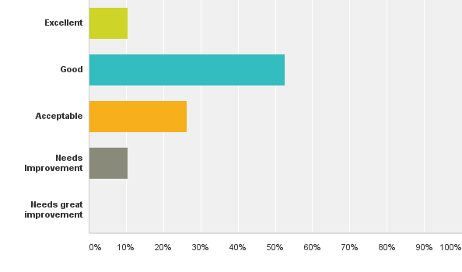
Q20: How would you rate technology on campus?
Answered: 19 Skipped: 0

Slide 42
Q20: How would you rate technology on campus?
Answered: 19 Skipped: 0

Slide 43
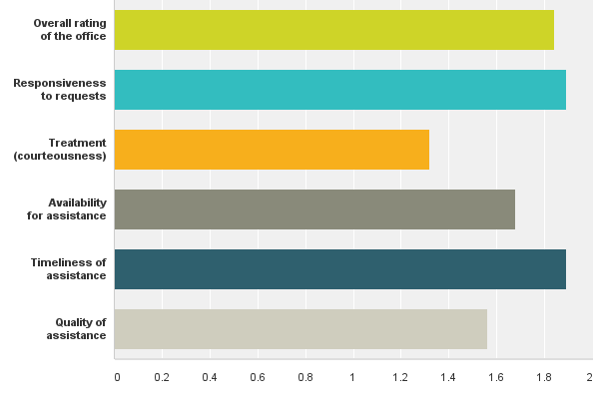
Q21: How would you rate the services you receive from the Office of the Dean?
Answered: 19 Skipped: 0

Slide 44
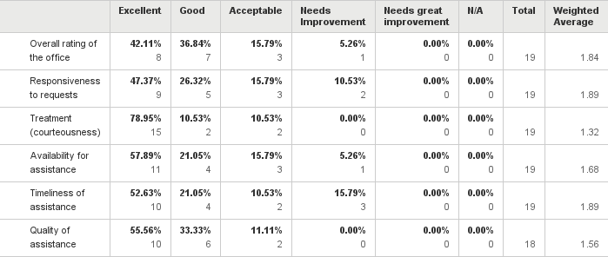
Q21: How would you rate the services you receive from the Office of the Dean?
Answered: 19 Skipped: 0

Slide 45
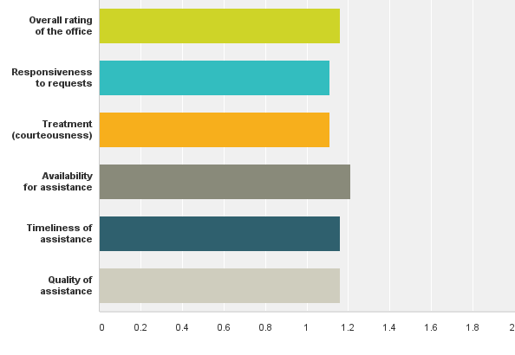
Q22: How would you rate the services you receive from the Librarian?
Answered: 19 Skipped: 0

Slide 46
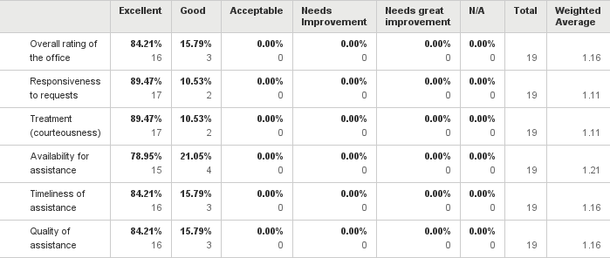
Q22: How would you rate the services you receive from the Librarian?
Answered: 19 Skipped: 0

Slide 47
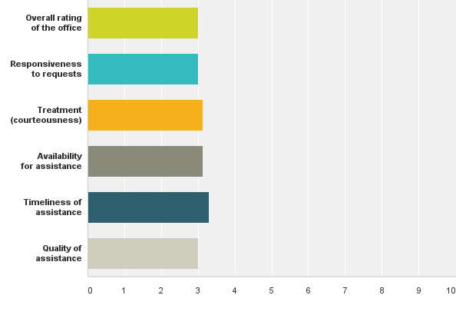
Q23: How would you rate the services you receive from the Office of Graduate Studies? (where applicable)
Answered: 15 Skipped: 4

Slide 48
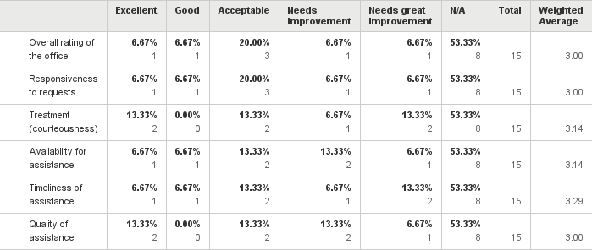
Q23: How would you rate the services you receive from the Office of Graduate Studies? (where applicable)
Answered: 15 Skipped: 4

Slide 49
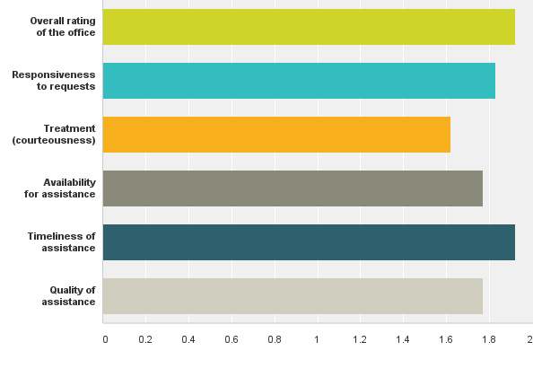
Q24: How would you rate the services you receive from the Office of the Registrar?
Answered: 18 Skipped: 1

Slide 50
Q24: How would you rate the services you receive from the Office of the Registrar?
Answered: 18 Skipped: 1

Slide 51
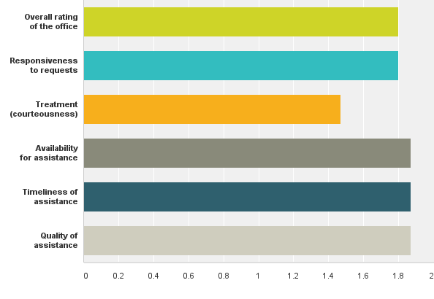
Q25: How would you rate the services you receive from the Business Office?
Answered: 18 Skipped: 1

Slide 52
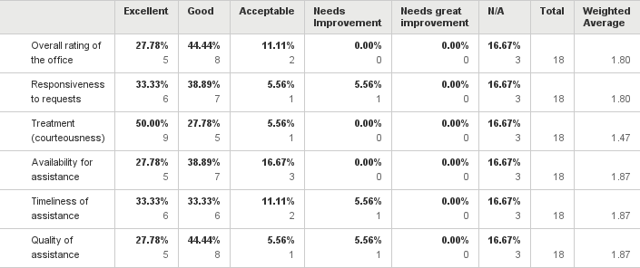
Q25: How would you rate the services you receive from the Business Office?
Answered: 18 Skipped: 1

Slide 53
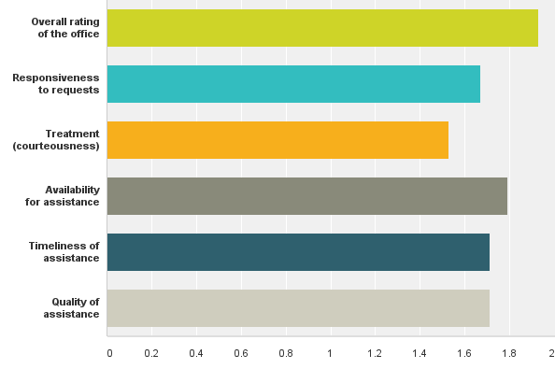
Q26: How would you rate the services you receive from the Office of the President?
Answered: 17 Skipped: 2

Slide 54
Q26: How would you rate the services you receive from the Office of the President?
Answered: 17 Skipped: 2

Slide 55
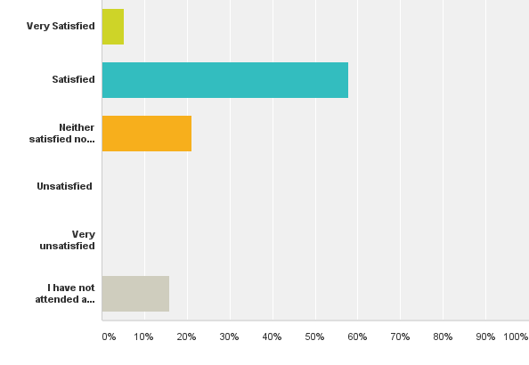
Q27: How would you describe your satisfaction with the faculty meetings you have attended?
Answered: 19 Skipped: 0

Slide 56
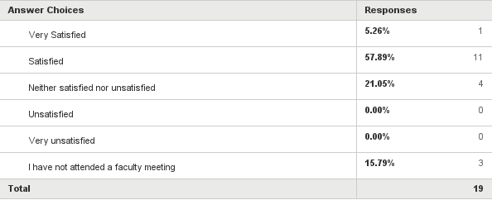
Q27: How would you describe your satisfaction with the faculty meetings you have attended?
Answered: 19 Skipped: 0

Slide 57
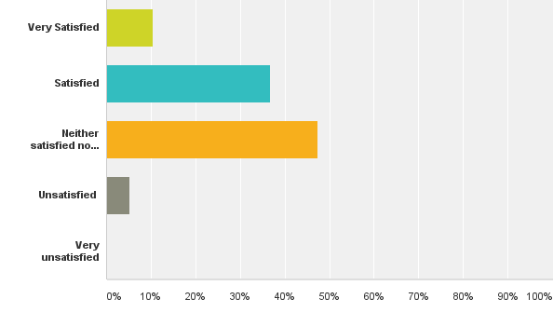
Q28: How would you describe your satisfaction with the professional development support you are receiving from ICCI to help improve your teaching skills?
Answered: 19 Skipped: 0

Slide 58
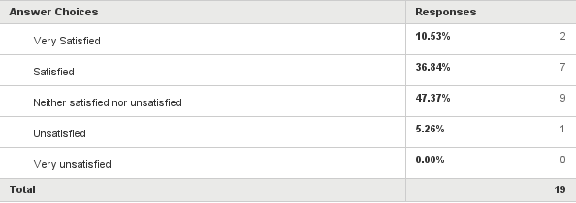
Q28: How would you describe your satisfaction with the professional development support you are receiving from ICCI to help improve your teaching skills?
Answered: 19 Skipped: 0

